Slide 1

Movie Ticket Reservation System DAMG 7275: Spring 2023
Team 7
KRUTIK KANAKIA (002787847)
KUMAR MEHUL (002761391)
MANSI UPADHYAY (002766397)
TANUJ VERMA (002726506)

Slide 2
CONTENTS
Objective
Architechture Diagram
Entity Relationship Diagram
Database Implementation
Visualization
Graph Model

Slide 3
OBJECTIVE
Create a Database System to store information
Use ETL to preprocess the generated data
Use visualizations to see the trend of the system
Implement ongoing data refresh for Database

Slide 4
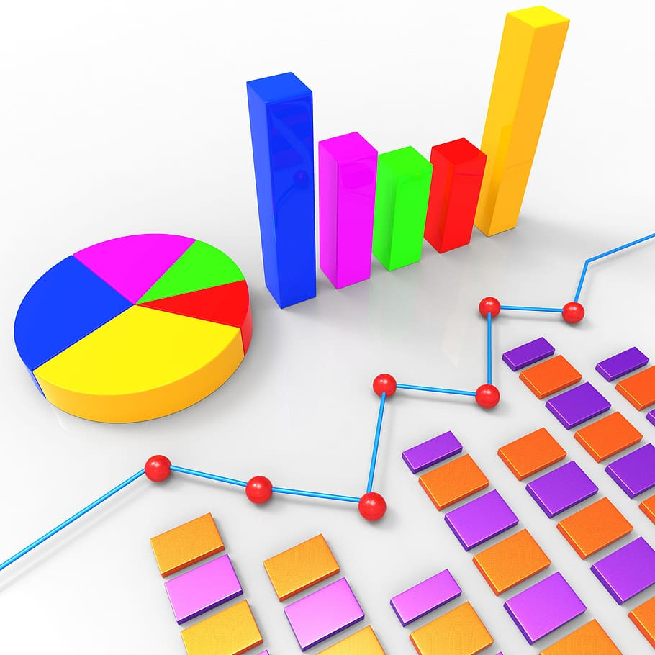




ARCHITECTURE DIAGRAM
Data Analysis
Data Generation
Data Preprocessing
& Refresh
Data Storage
Data Visualization

Slide 5
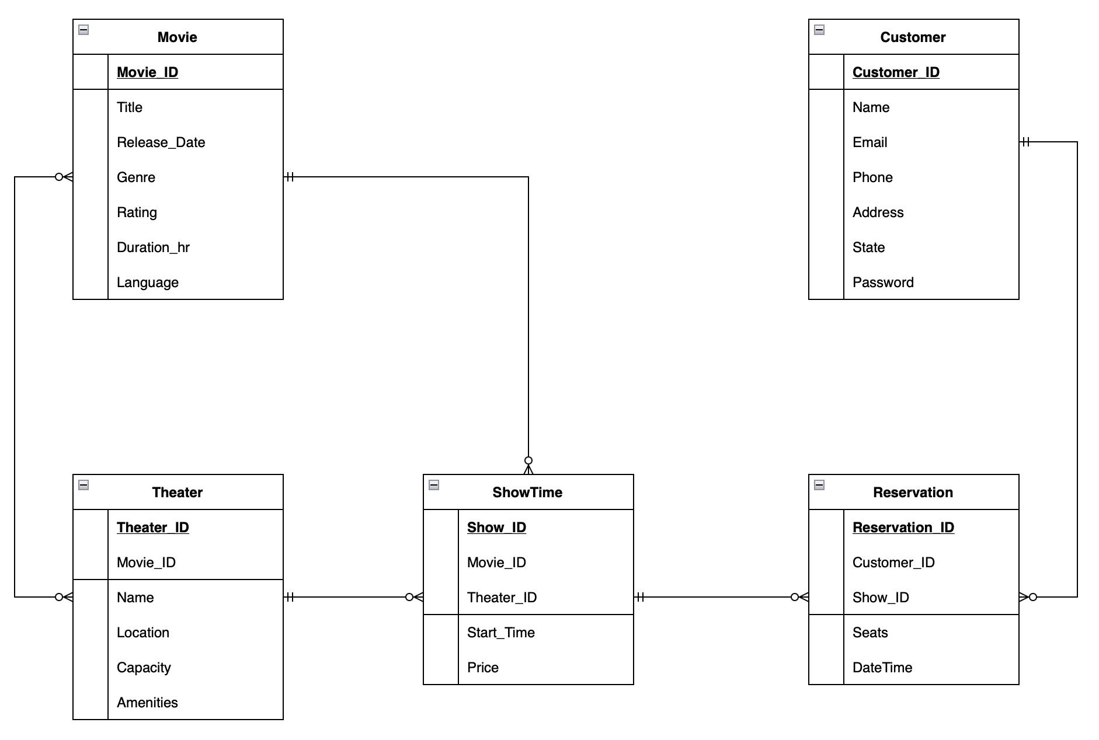
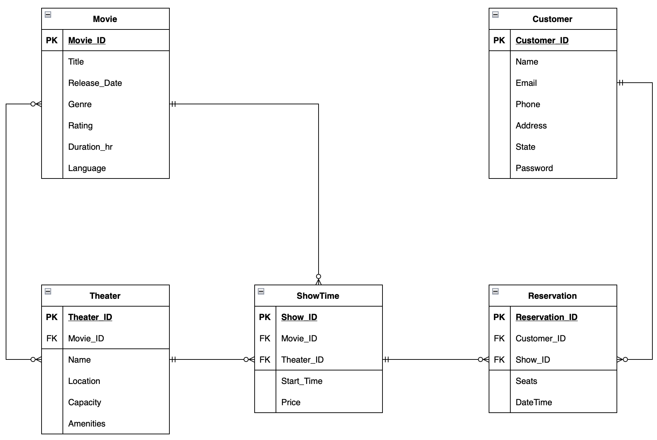
ENTITY RELATIONSHIP DIAGRAM

Slide 6
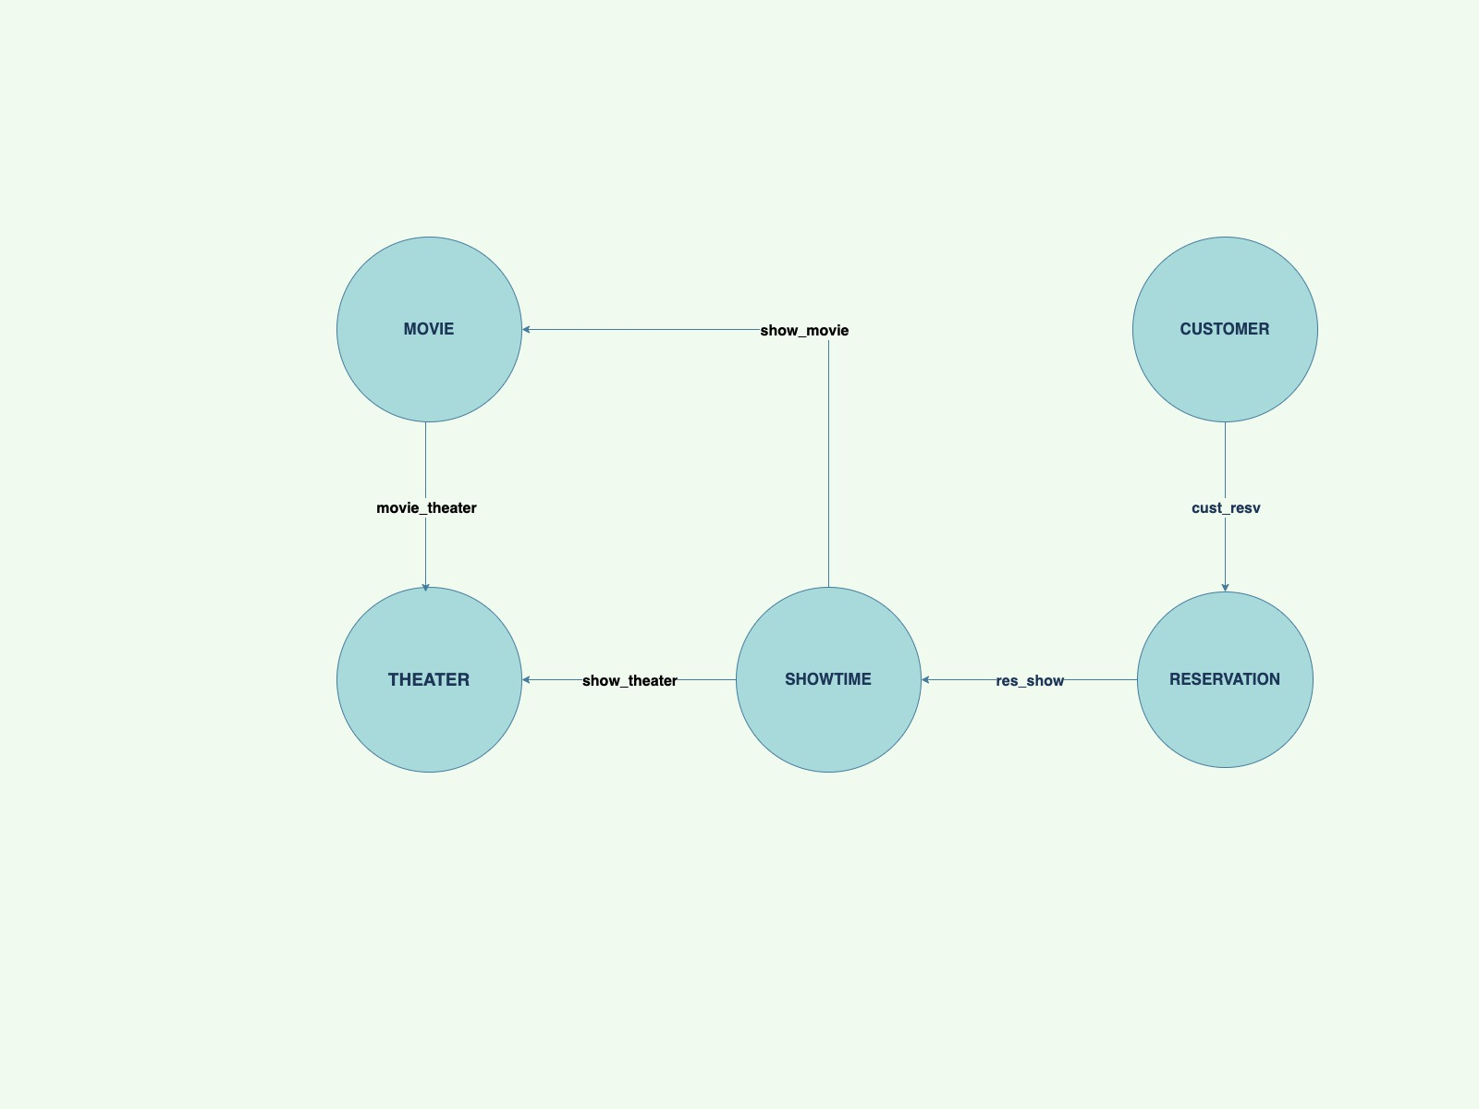
GRAPH MODEL

Slide 7
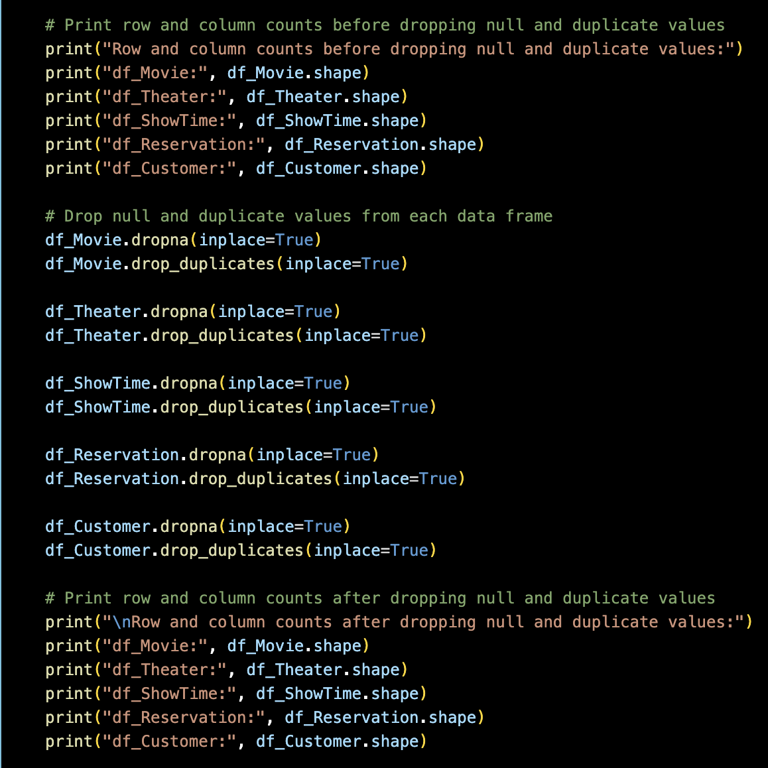
DATABASE IMPLEMENTATION
After generation of data from Mockaroo, python was used for preprocessing of the data, which was updated in the same csv and thus, became ready for importing to ArangoDB.

Slide 8
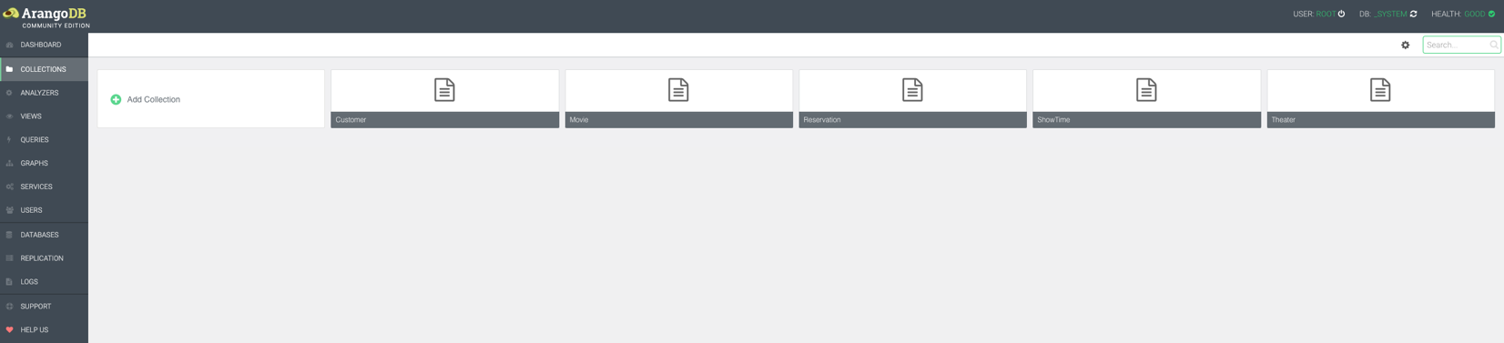
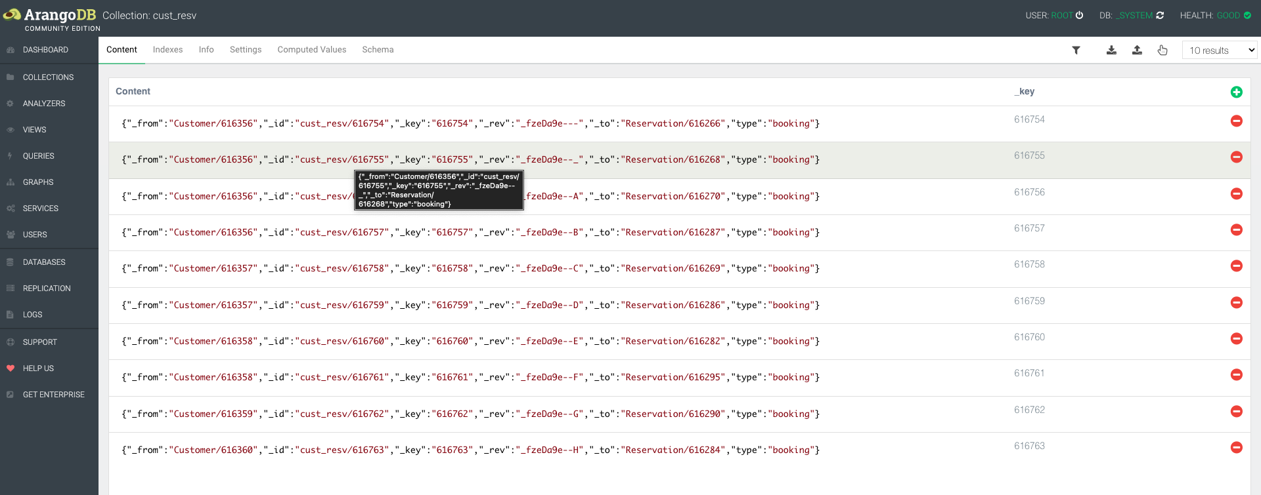
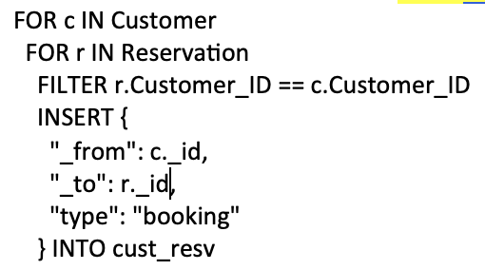
ARANGODB INTERFACE AFTER IMPORTING THE COLLECTIONS
CREATION OF EDGES

Slide 9
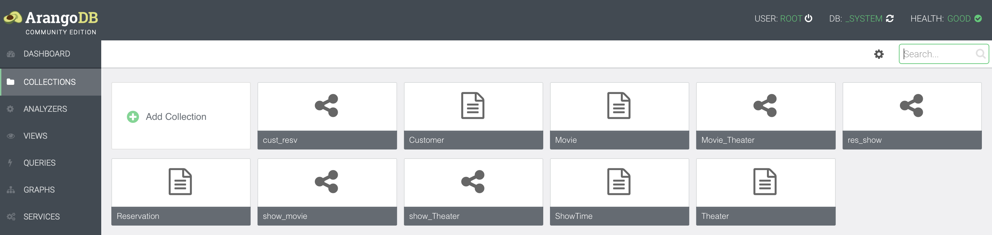
FULLY IMPLEMENTED DATABASE UI WITH COLLECTIONS AND EDGES

Slide 10
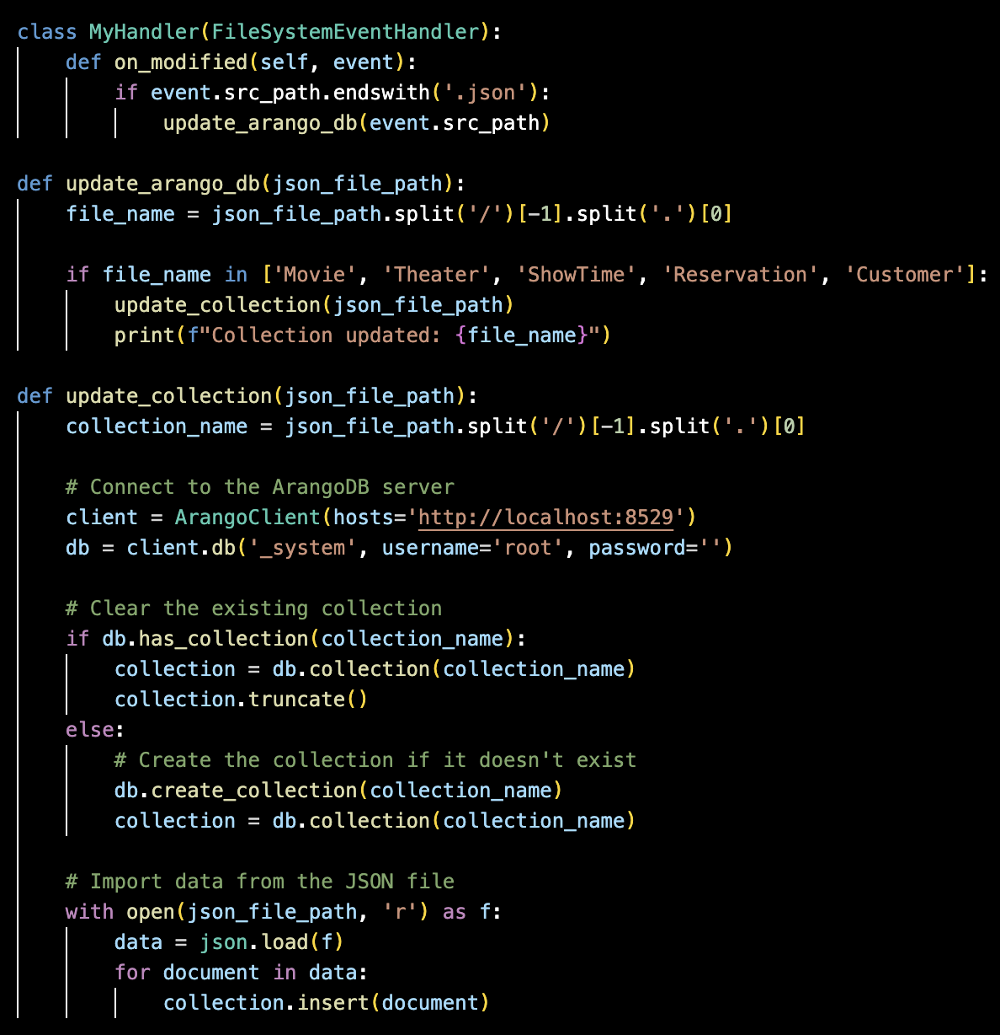
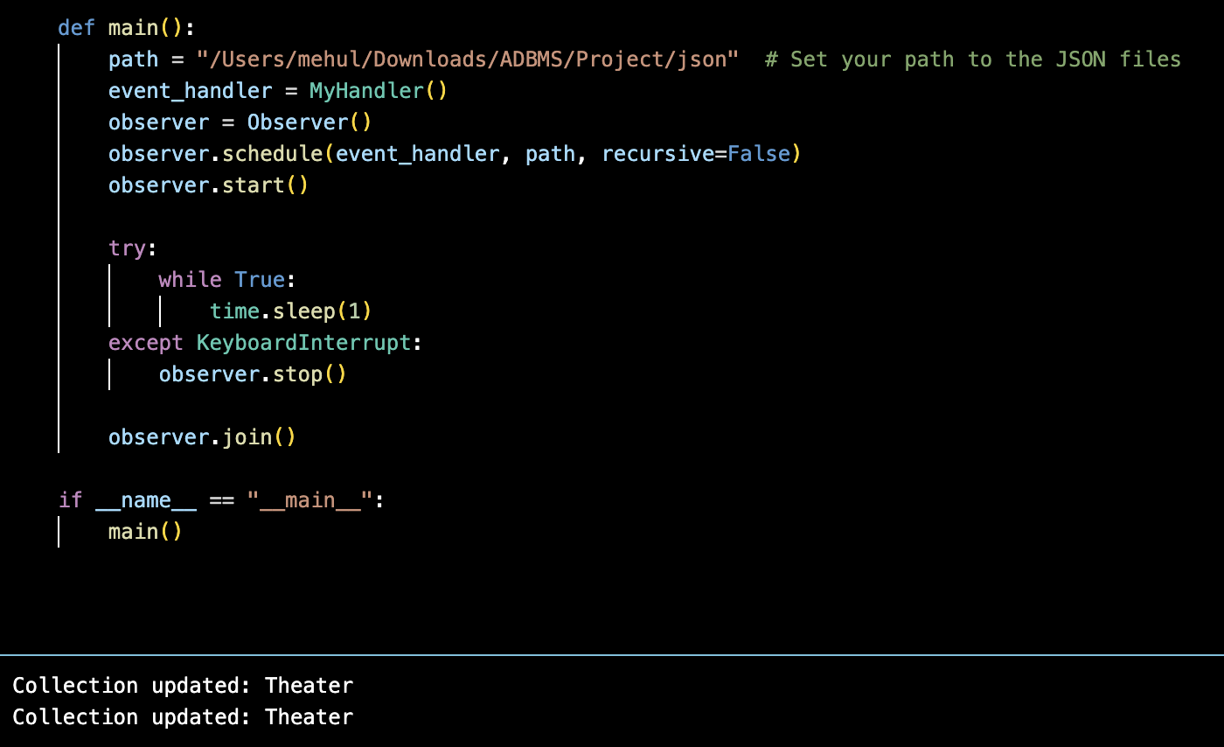
ONGOING DATA REFRESH IMPLEMENTATION

Slide 11
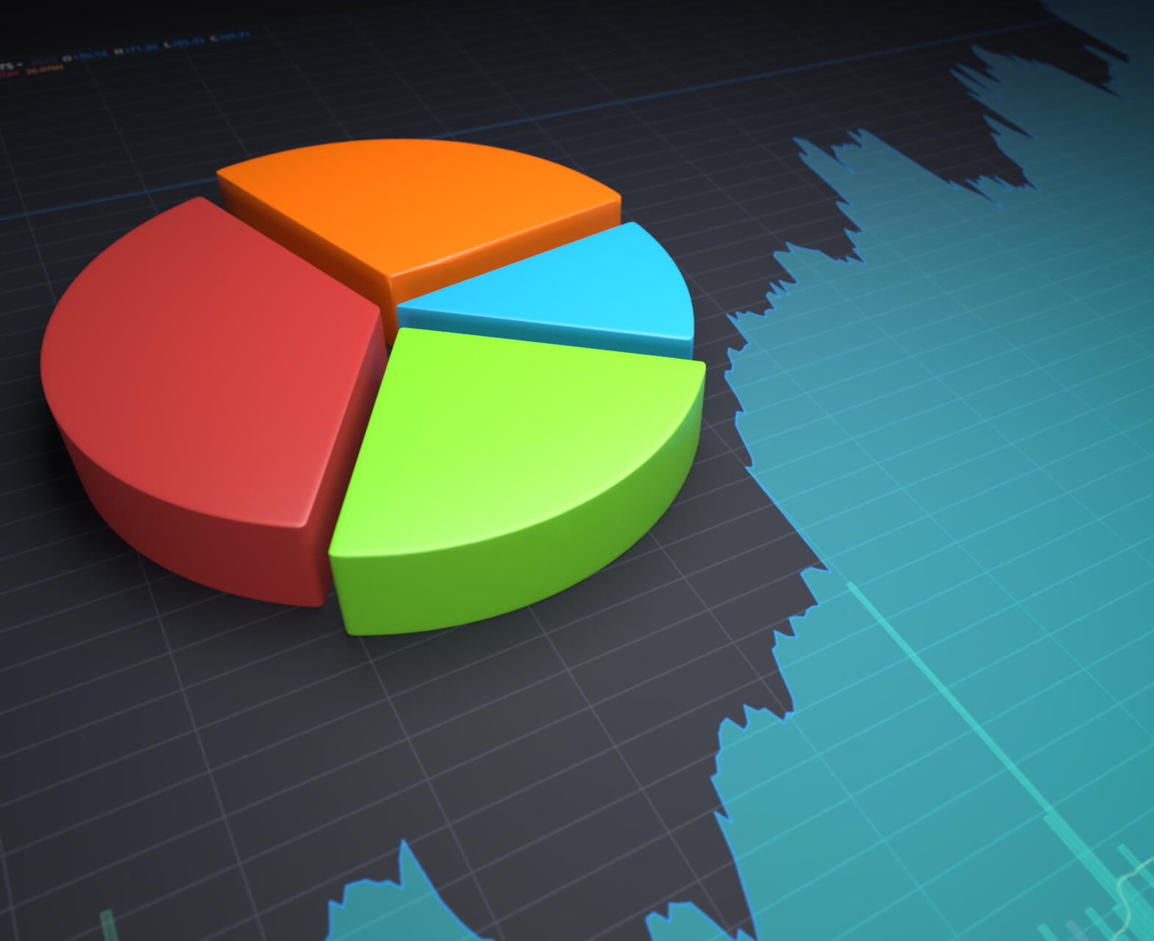
DATA VISUALIZATIONS

Slide 12
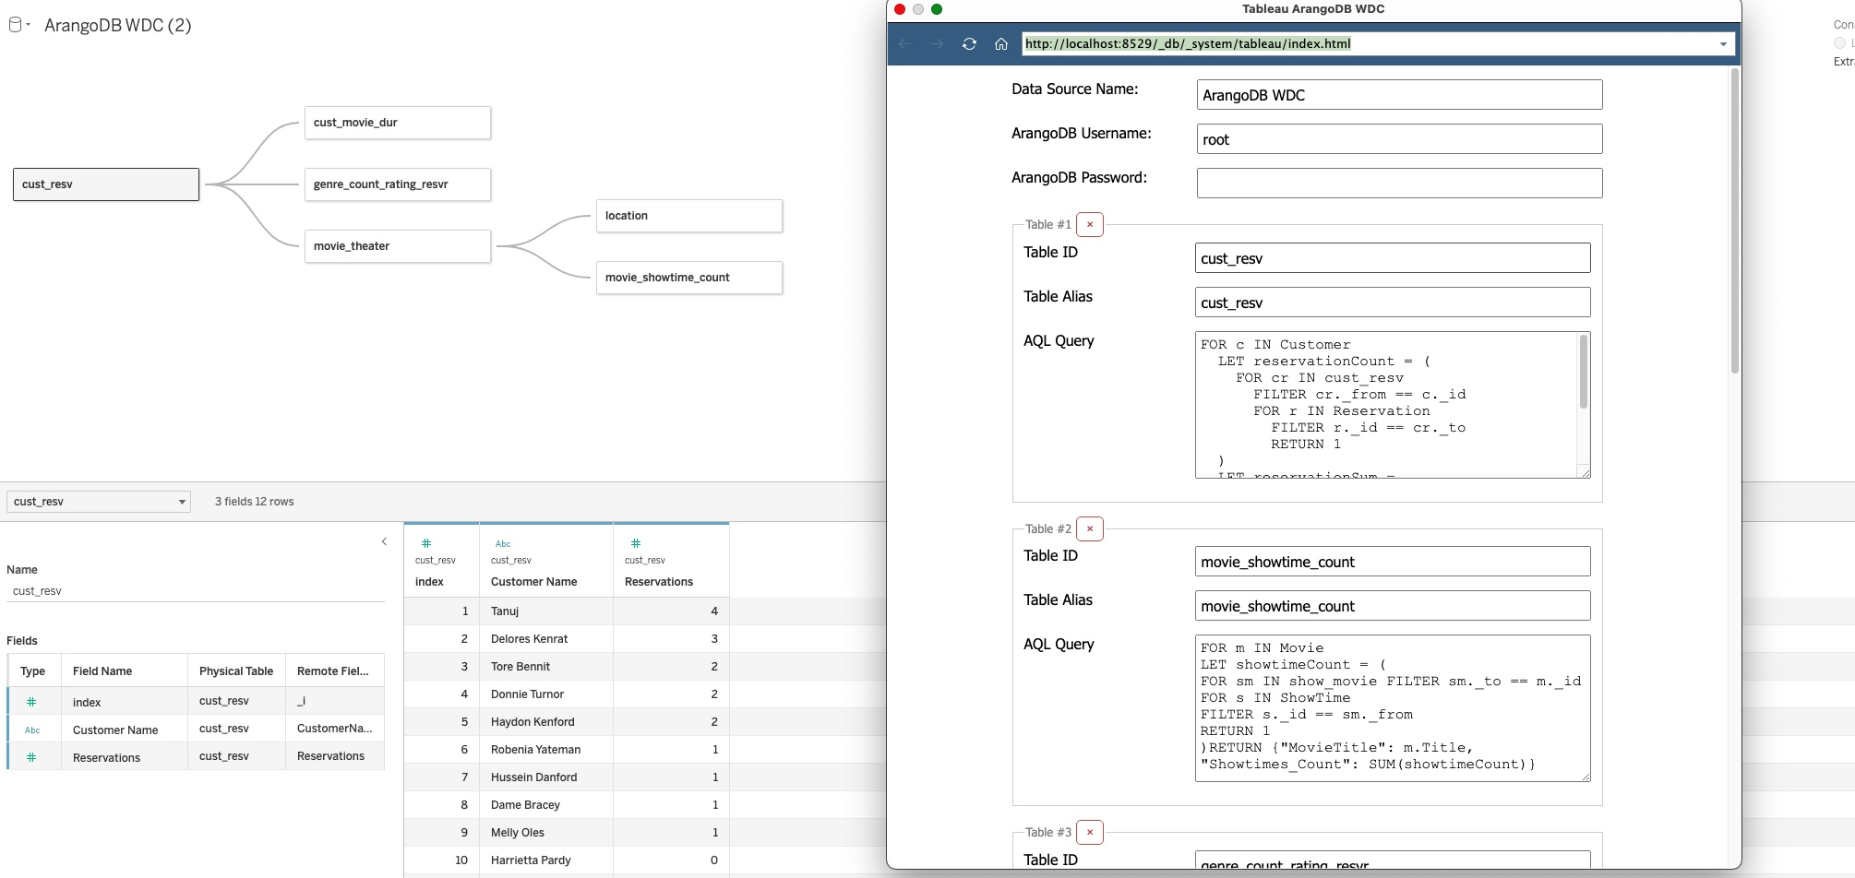
CONNECTION OF ARANGODB AND TABLEAU

Slide 13
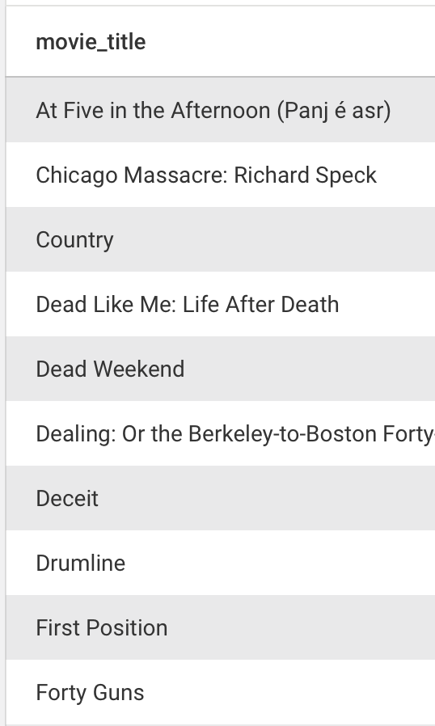
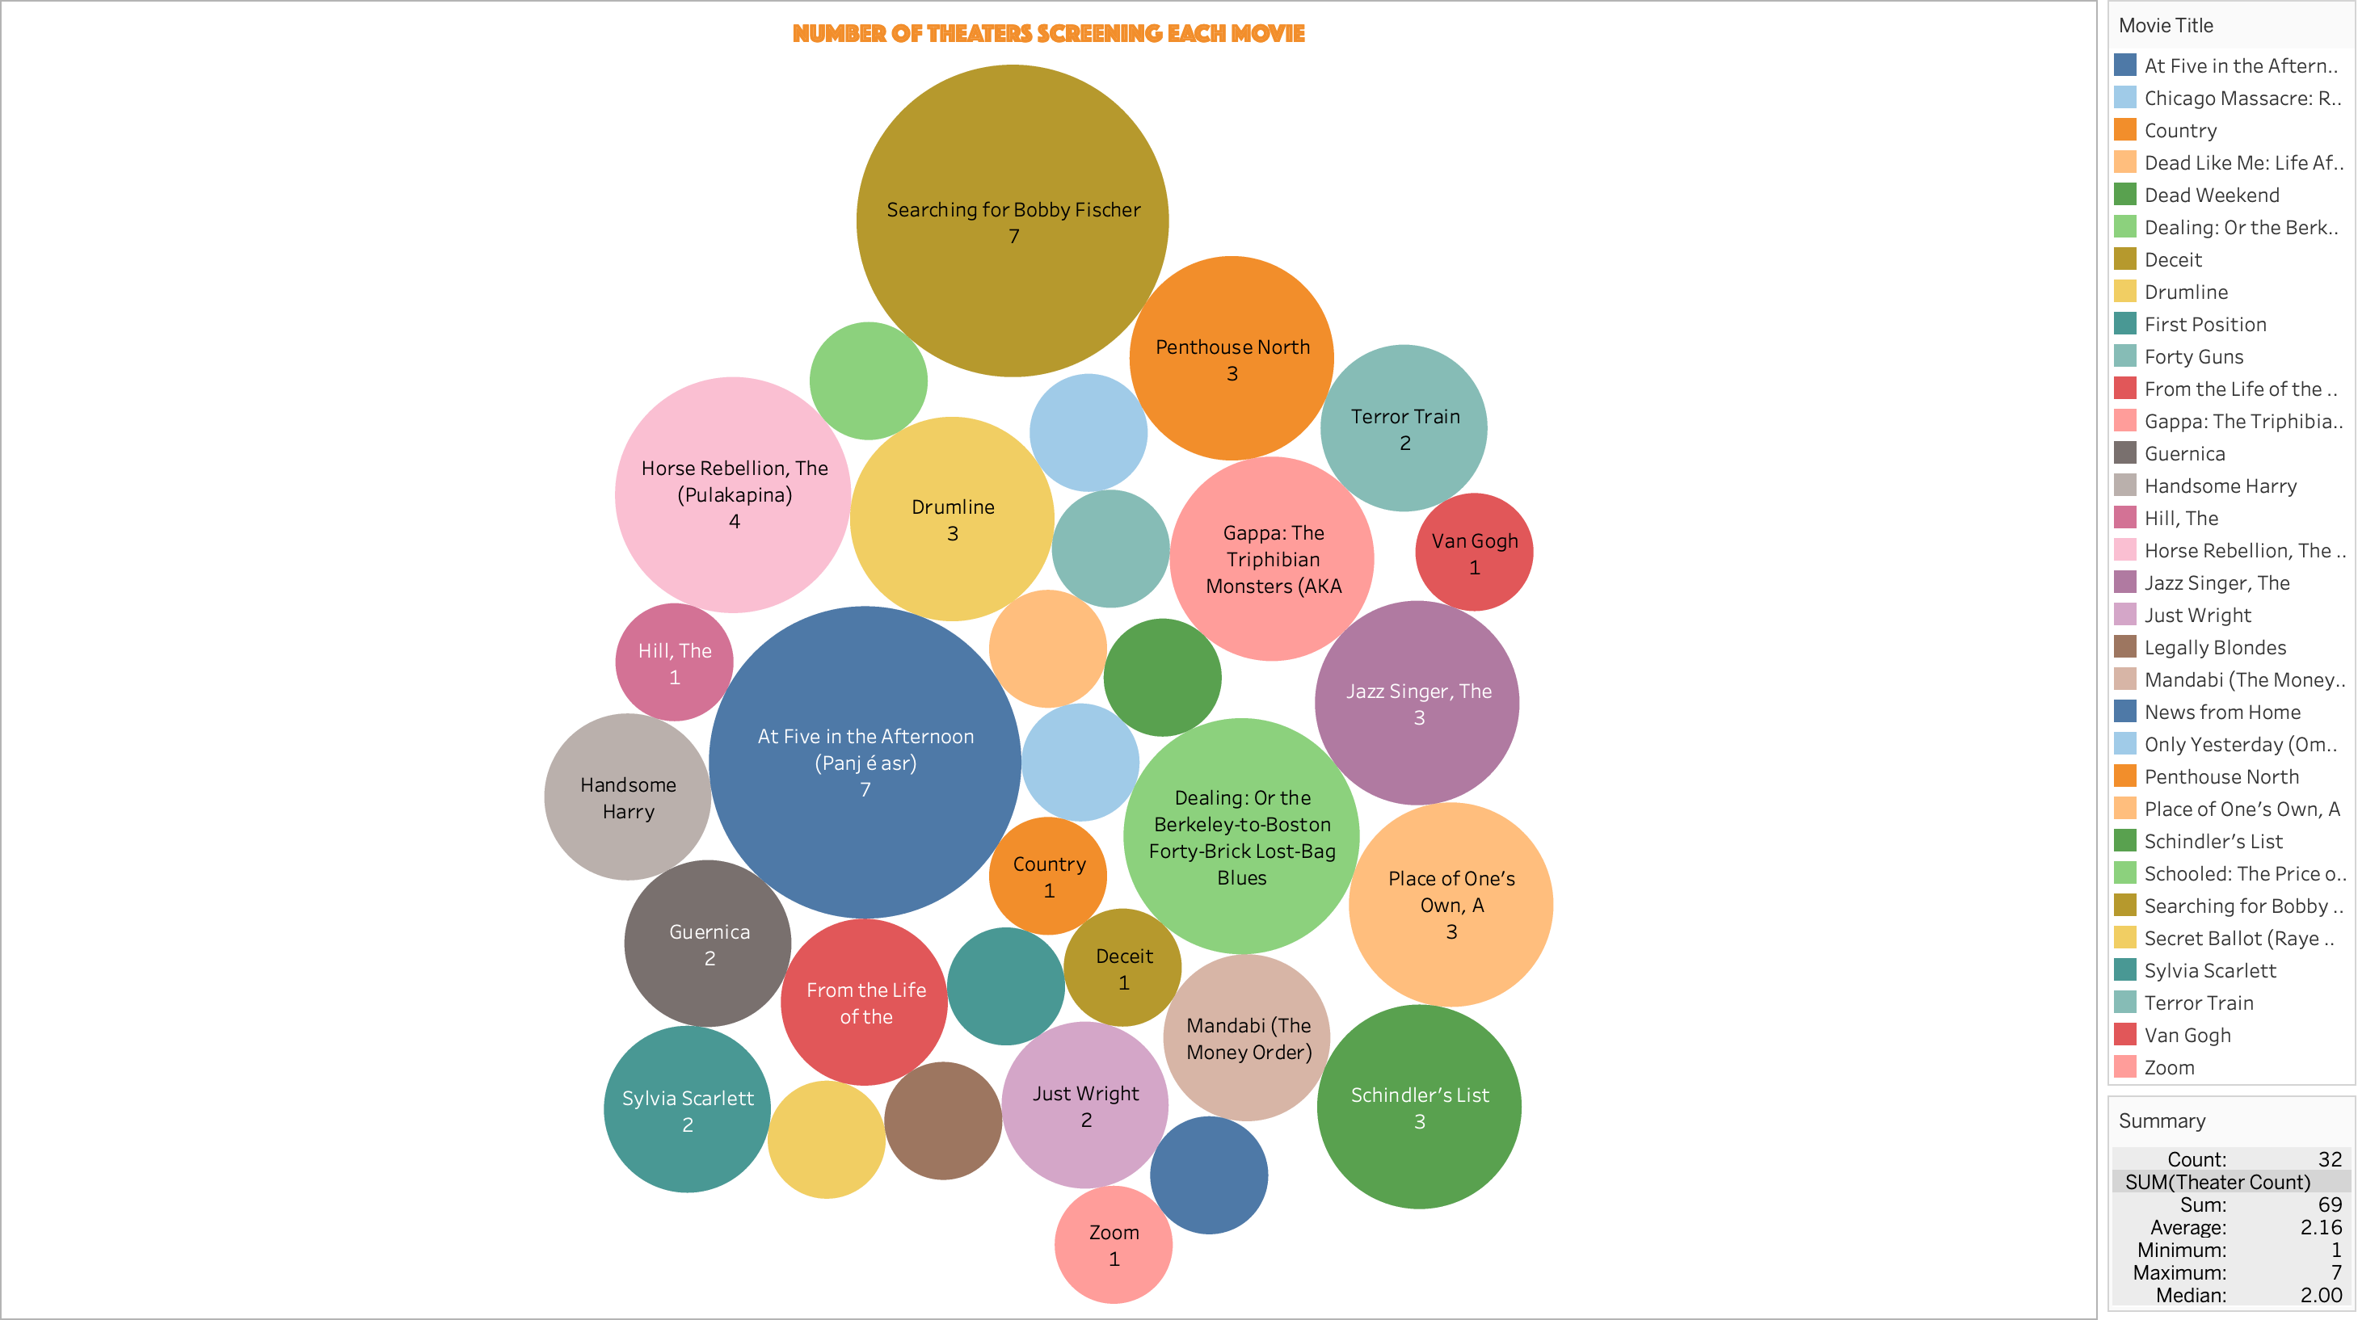
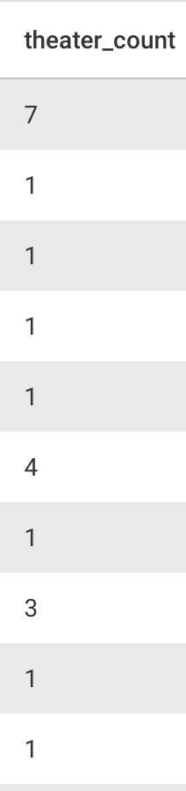
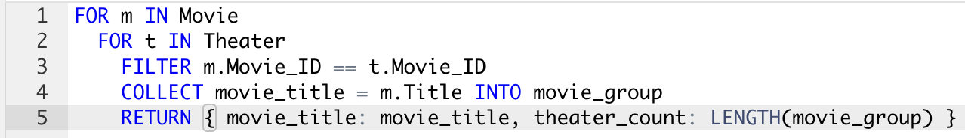

Slide 14
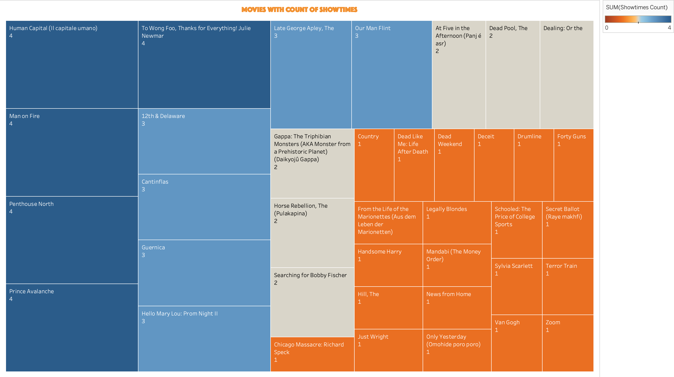
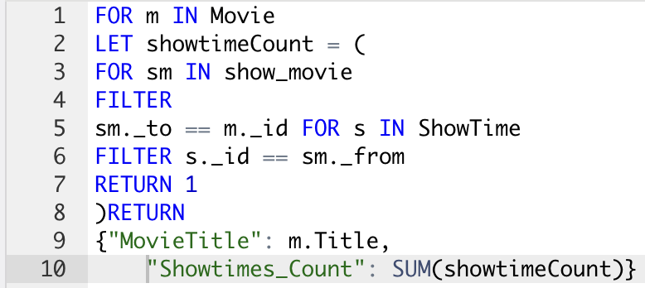
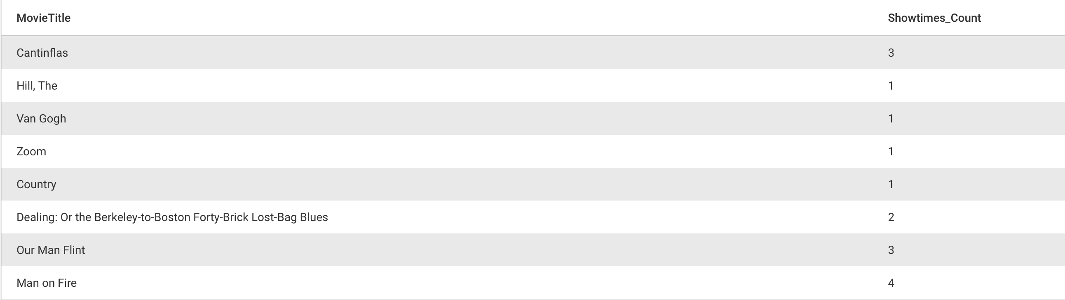

Slide 15
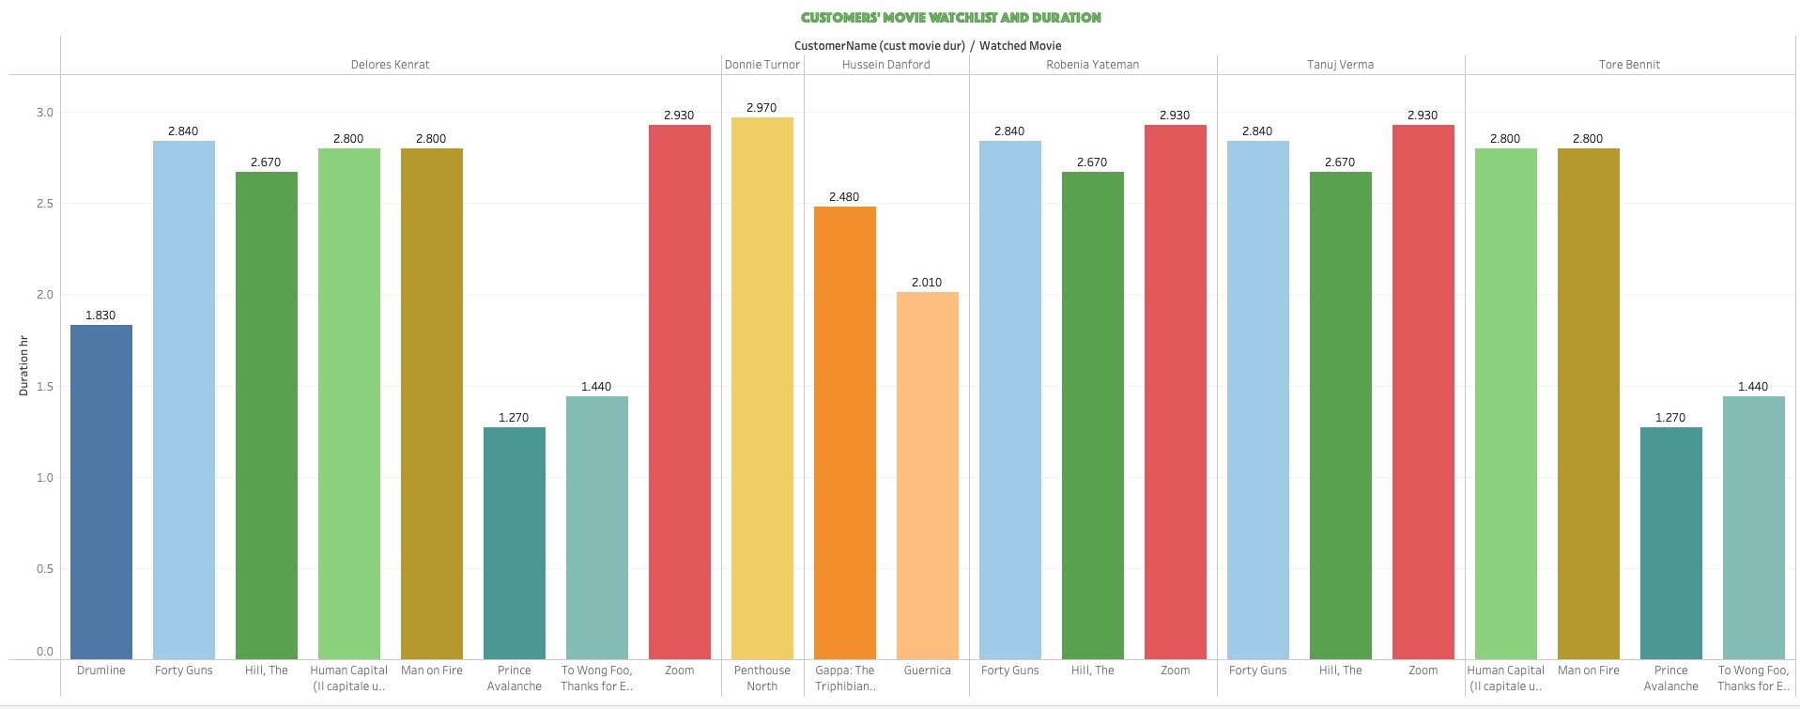

Slide 16
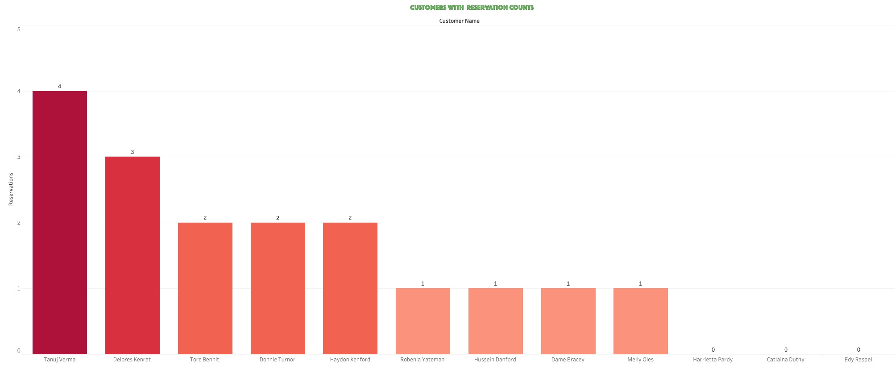

Slide 17
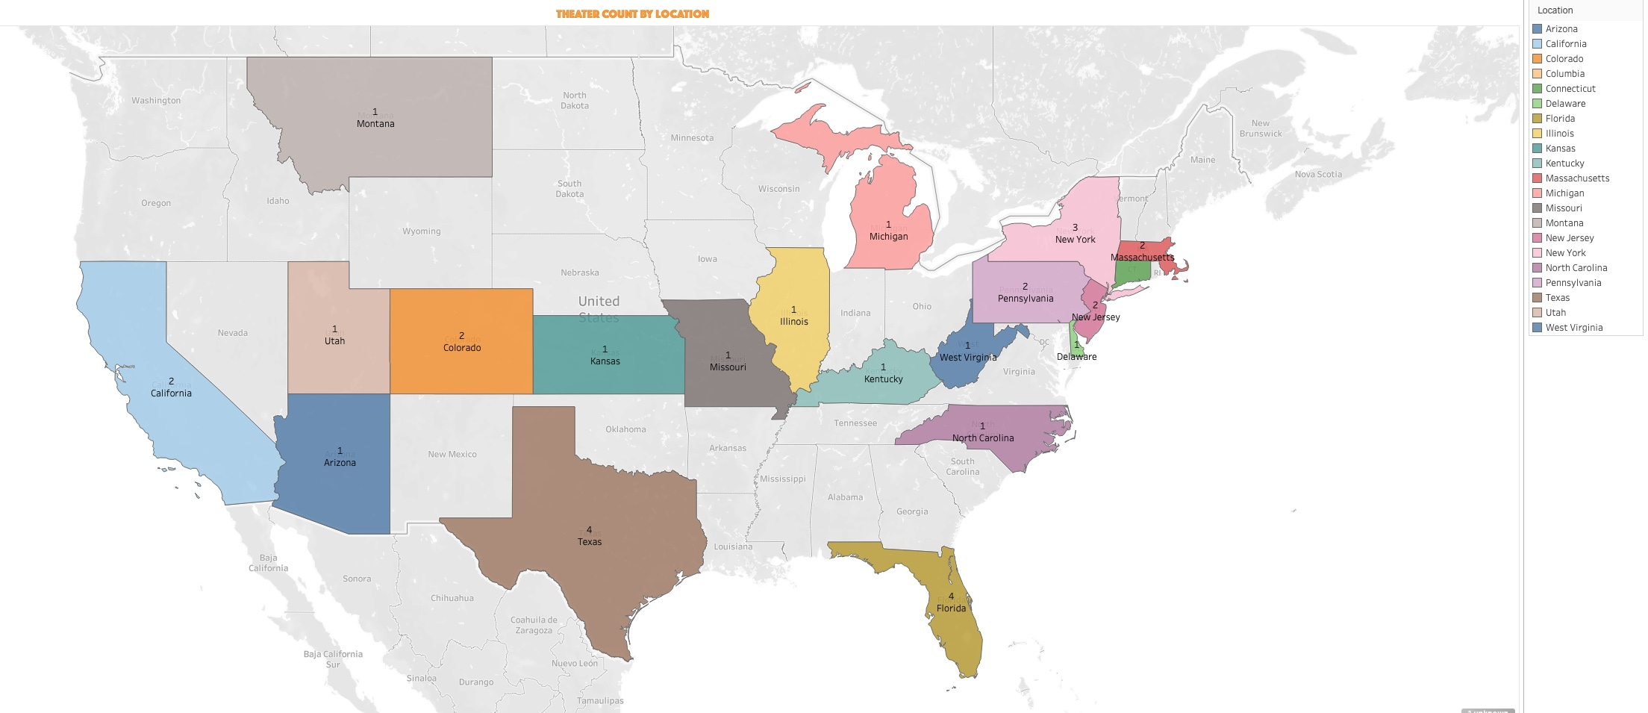

Slide 18
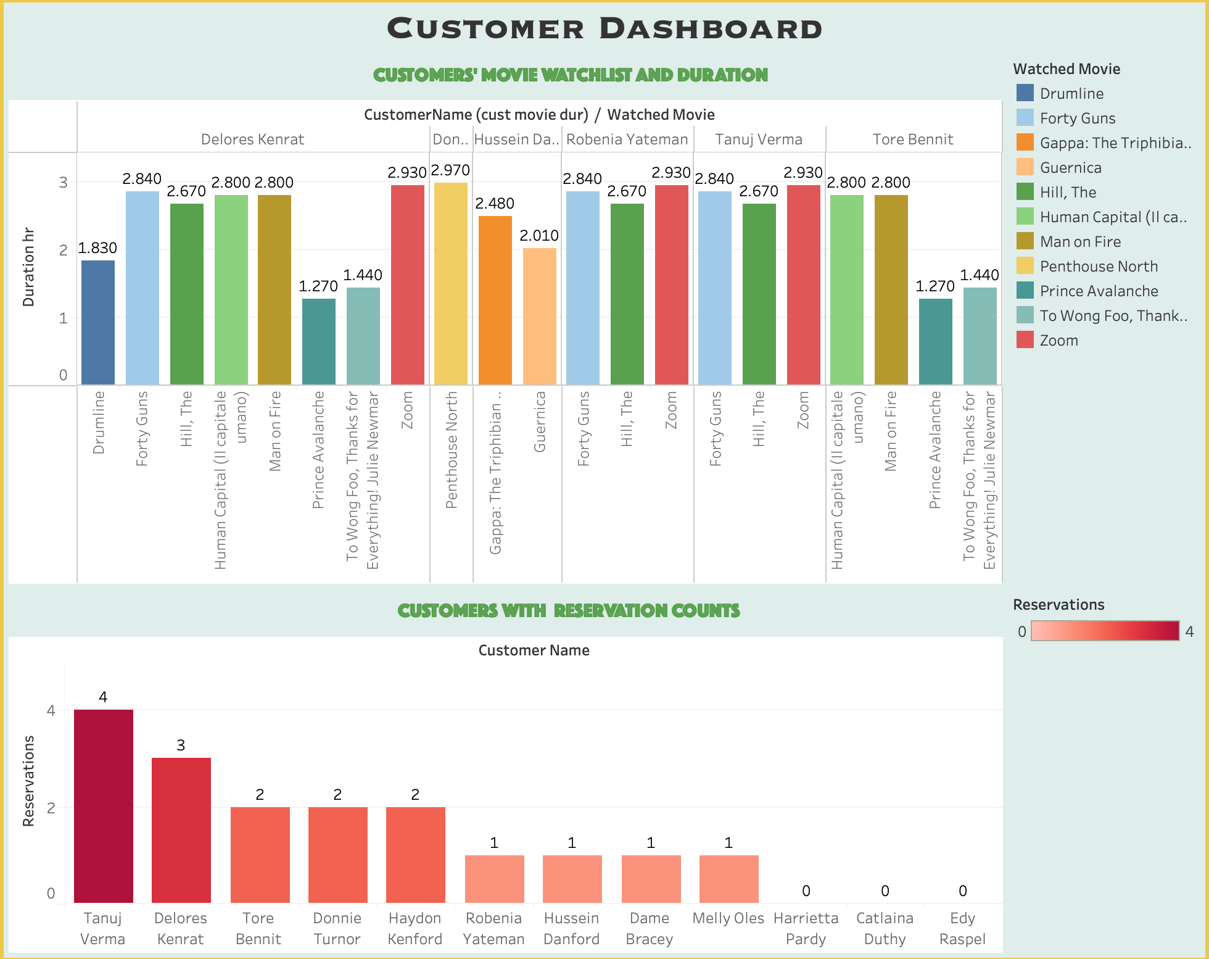

Slide 19
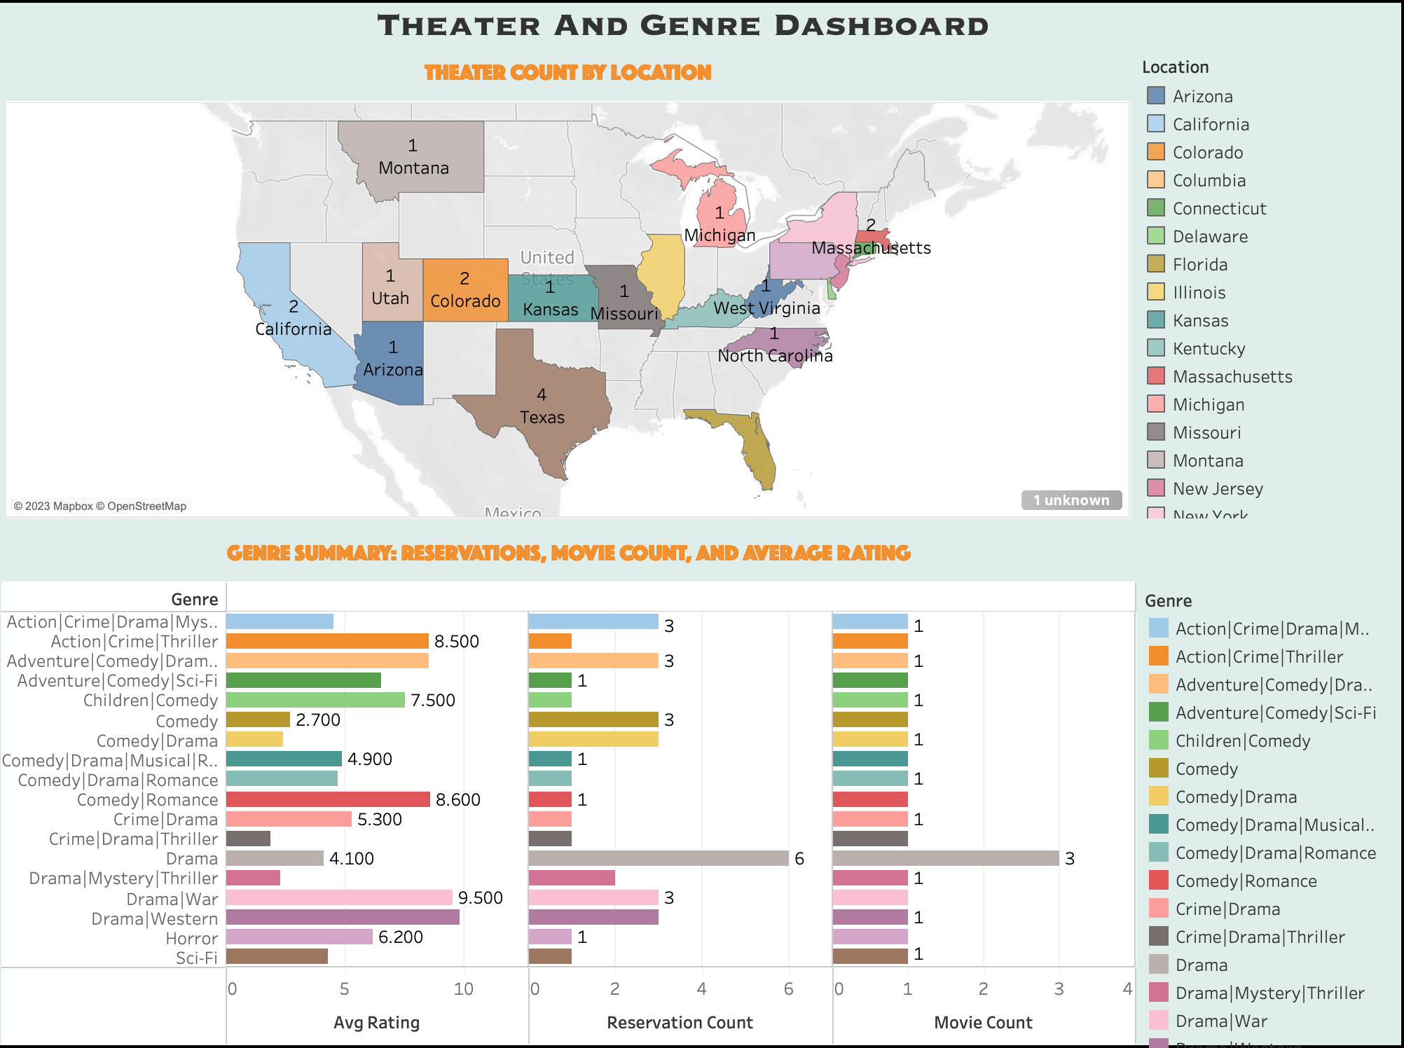

Slide 20

Q & A
Thank You

